Slide 1
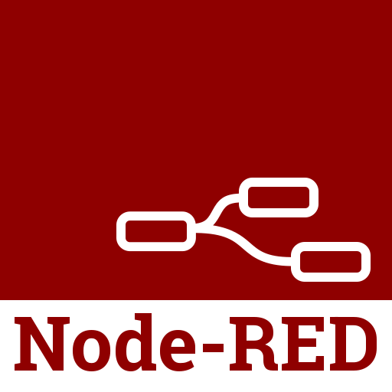
Linux Guest
1. Access your guest
Hyperledger Fabric
GitHub Repository
3. Interact with APIs and blockchain through NodeRed
Hyperledger Composer
2. Import files from GitHub & create project in Hyperledger Composer
Hyperledger Composer files
Composer Playground

